Slide 1
The 1st Homework Carry Look-Ahead Adder
Lecturer:周韋棋

Slide 2
Outline
作業內容說明
作業驗證說明
作業繳交注意事項

Slide 3
Outline
作業內容說明
作業驗證說明
作業繳交注意事項

Slide 4
Signal Introduction
Generate Signal G_{i} =A_{i} ⋅ B_{i}
Propagate Signal P_{i} = A_{i}​ ⊕ B_{i}
C_{i+1} = G_{i} + (P_{i} ⋅ C_{i})
A
B
G
CARRY
P
C
SUM

Slide 5
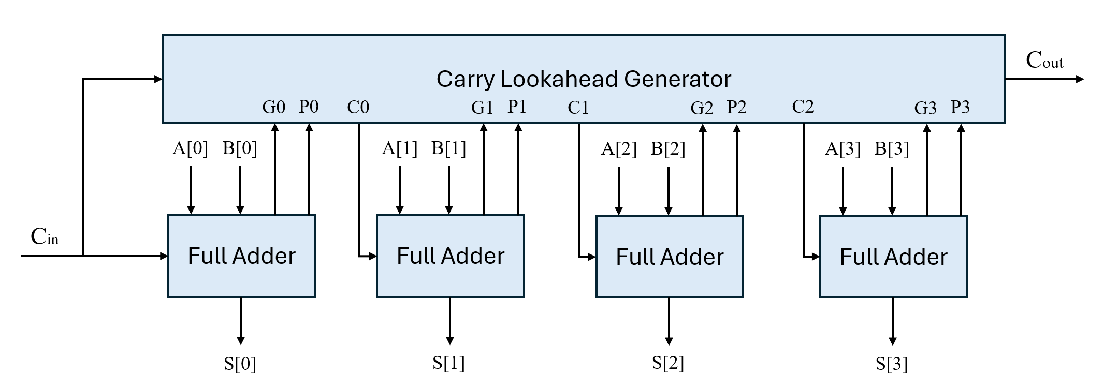
Carry Look-Ahead Adder Architecture
本次作業請以gate-level的設計完成
C₁ = G₀ + P₀C₀
C₂ = G₁ + P₁C₁ = G₁ + P₁G₀ + P₁P₀C₀
…

Slide 6
Specification
A[3:0]
S[3:0]
B[3:0]
top
Cout
Cin
Module | I/O ports Specifications
top | Name | Signal | Bits | Signal Explanation
 | A | Input | 4 | First operand
 | B | Input | 4 | Second operand
 | Cin | Input | 1 | Carry in
 | S | Output | 4 | Sum
 | Cout | output | 1 | Carry out

Slide 7
Simulation commands
Simulation | Command | Example
RTL simulation for different data | make rtlX | make rtl0
Dump waveform(no array) | make rtlX FSDB=1 | make rtl0 FSDB=1
Dump waveform(with array) | make rtlX FSDB=2 | make rtl0 FSDB=2
RTL simulation for all data | make rtl_all
Open nWave with fsdb | make nWave
Delete build file for simulation | make clean
Compress homework to tar format | make tar

Slide 8
Outline
作業內容說明
作業驗證說明
作業繳交注意事項

Slide 9
Function correctness
提供的測資
Data1 (20%)
Data2 (20%)
Data3 (20%)
隱藏測資 (助教Demo)
Data4 (20%)
Data5 (20%)

Slide 10
Outline
作業內容說明
作業驗證說明
作業繳交注意事項

Slide 11



作業繳交形式
top_tb.sv
data.dat
ans.dat
sim
your design (.v)
src
StudentID.tar
Makefile
StudentID

Slide 12
作業繳交期限
2025/03/18(二) 14:00前繳交
遲交作業者，可以接受補交，作業成績8折
請依照繳交格式上傳至Moodle
每次的作業期限皆為2週

